Slide 1
Fundamental Technologies Used in PyPy JIT Compiler
PyConJP 2012
Ryotaro Ikeda, 2012/09/06

Slide 2


whoami
Studied about JIT compiler
But, I am now one of working adults (since this April)
And, I was a salesperson (telephone caller) during new graduate’s training
I almost forgot about PyPy! ;-(

Slide 3
Disclaimer
My English is extremely poor
My presentation skill is extremely low
Please feel free to
Ask any question anytime
Leave/Reenter
Of course I can explain in Japanese and English

Slide 4
Today’s topics
What is PyPy?
What is JIT compiler?
What is unique features of PyPy JIT compiler?

Slide 5
What is PyPy?

Slide 6

Please raise your hand if you know briefly what PyPy is?

Slide 7
PyPy is regarded as …
Faster python implementation
Framework used to develop language implementation
Both are definitely correct!

Slide 8
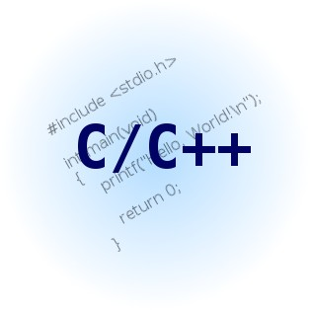
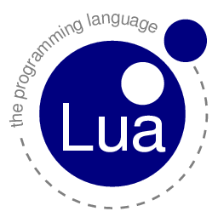


Current woes and PyPy’s goal
Problem
Creating interpreter requires a lot of work
For performance!
Language-based programming
PyPy’s goal
To be able to create interpreter easily
With high-level language like Python
Without giving up performance

Slide 9

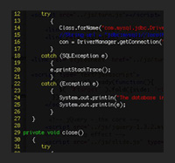

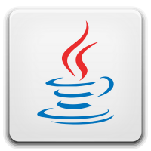

Principle what PyPy do
Toolkit to translate interpreter written in RPython to other backends(C/CLI/Java..)
C (native)
Java
Implementer
Interpreter code
Written in RPython
PyPy
CLI

Slide 10
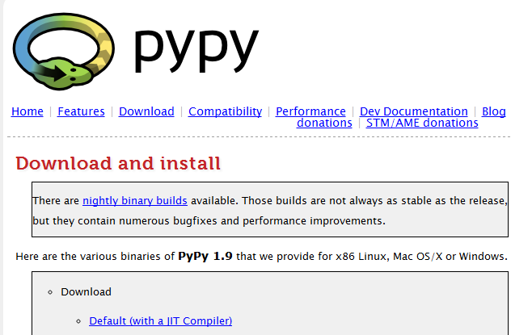
Python implemented by RPython
Python
Implementer
C (native)
Python code
Written in RPython
PyPy
This is what they know!

Slide 11
What is RPython?
It is abbreviated for Restricted subset of Python
Only single inheritance is allowed
“For loop” only supports built-in type
Generator is supported, but exact scope is very limited
Dynamic dispatch to class is not supported
These are required to static analysis
(it is for translating other back-ends)
* RPython can be executed by CPython!

Slide 12
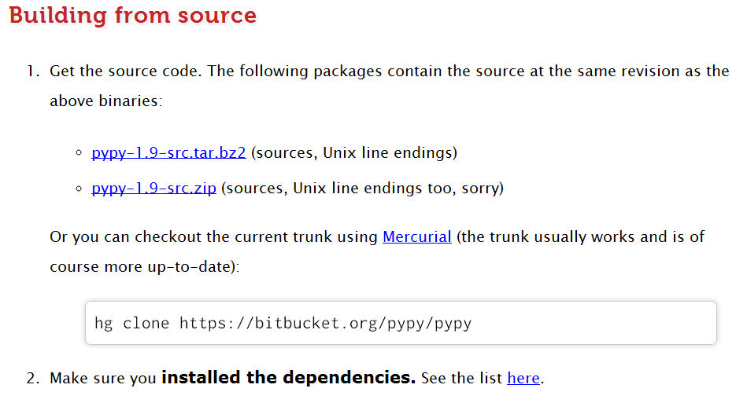
How to use PyPy (as framework)?
1. Download source code edition of PyPy
* Toolchain is not contained in binary distribution

Slide 13
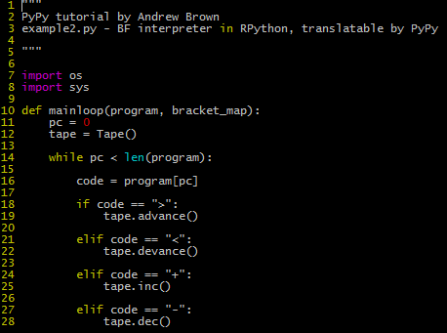
How to use PyPy (as framework)?
2. Write interpreter code in RPython
* It can also be executed by CPython

Slide 14
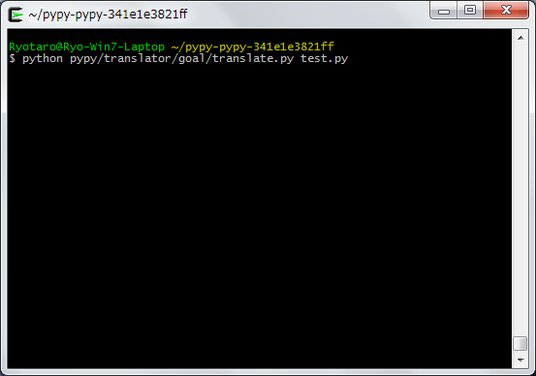
How to use PyPy (as framework)?
3. Use translater
* translate.py produces executable binary file from program written in RPython

Slide 15
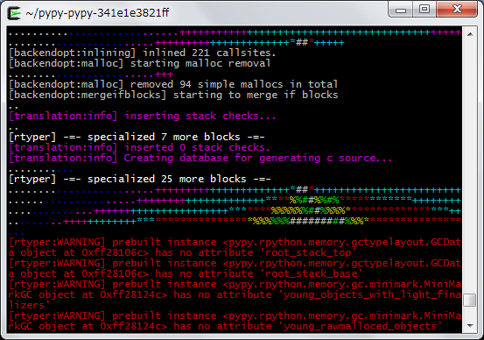
How to use PyPy (as framework)?
3-2 . Translating…
* It can also be executed by CPython

Slide 16
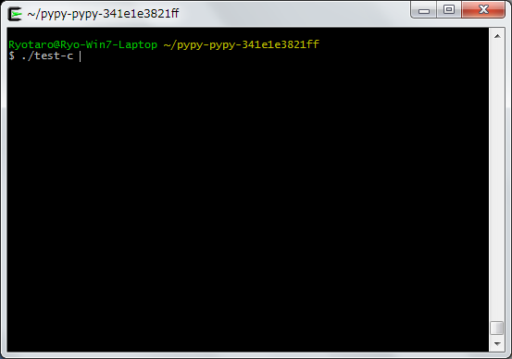
How to use PyPy (as framework)?
4. Now it’s ready to use!
* Executable binary which has suffix “-c” is created!

Slide 17
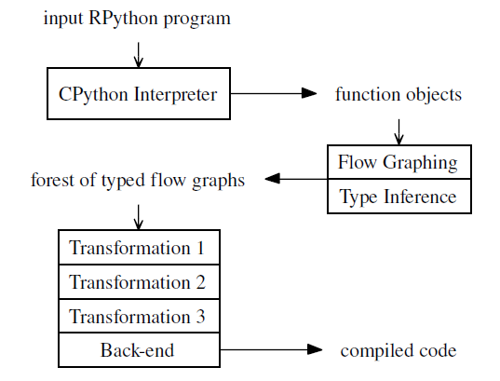
What PyPy did for given RPython code?
Note
Things are very similar to compiler,
but, it does a lot of extra work
It also can be done:
Adding GC
Adding JIT compiler
Automatically!

Slide 18
Summary of "What is PyPy?"
PyPy is
Framework to implement VM by high-level language
Tool which enables translate RPython to efficient executable one
To be able to executing natively
JIT / GC can be automatically used to do that

Slide 19
What is JIT compiler?

Slide 20
Please raise your hand if you have any understanding about JIT compiler

Slide 21

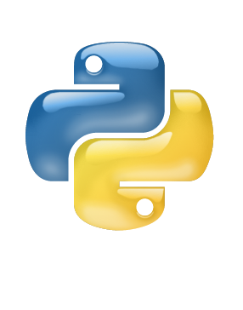
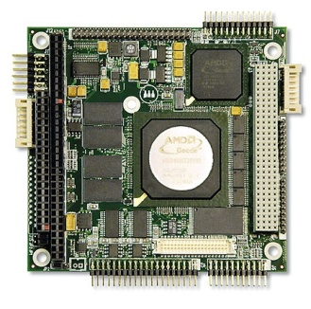

JIT compiler = Just-In-Time compiler
VM with JIT compiler
VM is in charge of:
Understanding script
Instructing to machine
Compiling script in runtime
VM
Physical
Machine
Script
Compile partial code during runtime to make it faster!
Compiler

Slide 22
What is JIT compiler?
= Compiler which compiles executing script
* Anytime
* Any parts
to speedup later execution speed!

Slide 23
Comparison: difference between typical compiler and JIT compiler
 | Typical compiler | JIT compiler
Done | During compile phase | During runtime
Time | A lot of time is acceptable | Very limited
Target | Typically whole code | Typically partial code

Slide 24
What does partial compilation?
JIT compiler cannot use a lot of time
-> So, it cannot compile overall code
Compile frequently executed parts only!

Slide 25

Way of doing partial compilation
Function-based
Trace-based
Minimum compilation
unit is function
Minimum compilation unit is trace (sequence of running code)
Merit:
Easy to detect, implement
Demerit:
Minimum compilation unit is up to implementer of functions
Merit:
It can minimize compilation unit (much efficient)
Demerit:
Difficult to implement, still under research (later discussion)

Slide 26
Trace-based JIT How to detect frequently executed part?
Counter
HOT!!
LOOP
LOOP
Process
Process
Compiled, run faster

Slide 27
How will trace be extracted?
Please assume this loop is
usually executed and x is usually 3
Frequently executed part
loop
while (something) :
if x == 3 : hoge()
elif ...
...
YES
x==3
NO
hoge()
...
loop_start
Guard (x==3)
hoge()
loop_end
loop
Guard(x==3)
hoge()

Slide 28
What is Guard?
Conditional branch to switch interpreter execution / native execution
If guard is True,
continue to execute natively
loop
Guard(x==3)
If guard is False,
switch to execute by
interpreter
hoge()
It is used to assure not to execute parts which isn’t compiled during it is executed natively.

Slide 29
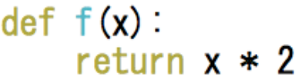
By the way, is Python compile-able?

Slide 30
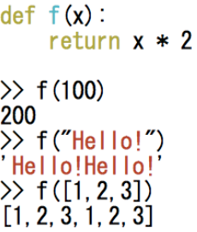
NO, IT ISN’T
Python is
dynamic-typed language
-> Various type of
machine-code is required

Slide 31
Use Guard to compile each types
(Example)
Assume f(x) is used by passing integer
parameter frequently

Slide 32
Before compilation
Compiled flow
Execution
Switches!
f(x)
f(x)
YES
Is x int?
Process
( VM )
NO
Process
( native )
Process
( VM )
return x
return x
Guard

Slide 33
It can support compiling multiple type!
f(x)
YES
Is x int?
NO
Process
( VM )
Process
( native for int )
YES
Is x str?
NO
Process
( native for str)
return x

Slide 34
Summary of "What is JIT compiler?"
Compiler used during run time
to compile partial code
to make it able to be executed efficiently
Two ways to partial compilation
Function-based : easy to implement, not efficient
Trace-based : difficult to implement, very efficient
In trace-based, guard does important role
To assure to run in native correctly
Enable partial python code to be compiled

Slide 35
What about JIT in PyPy?

Slide 36
PyPy says…
Once you implement VM in RPython, PyPy implements JIT compiler for it automatically
... How?
Does it generate JIT compiler?

Slide 37
Strategy to add JIT to target VM
Implementing JIT compiler is a heavy task
PyPy made only one JIT compiler for RPython
User write their interpreter by RPython
PyPy's JIT compiler works for the interpreter => Equivalent to supporting JIT to target interpreter

Slide 38
Sandwich architecture used in PyPy
Target program
Interpreter written in RPython
PyPy's JIT compiler

Slide 39
Meta-tracing (new technology introduced by PyPy)
Typical tracing
* Record execution path for implemented language
* 1 JIT for 1 language implementation
PyPy's meta-tracing
* Record execution path for language which implements target language
* 1 JIT for any language implementation

Slide 40
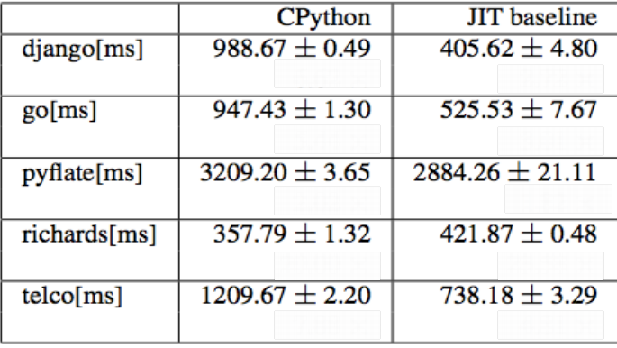
What about speed?
Roughly two times faster than CPython

Slide 41
Why is it able to make it faster?
That's because data operation will be target for JIT
(In general, such operations are out of scope for JIT compiler)
Guard increases opportunity for constant-folding
It is very efficient to apply constant folding to data operation

Slide 42
Summary of "What is PyPy's JIT compiler"
PyPy 's compiler doesn't "generate" JIT compiler
But, it traces VM written in RPython
Meta-tracing : It records VM's instruction, not program's instruction (meta-level) (It is realized by introducing sandwich architecture)
In meta-tracing, it achieves about 2x speed up

Slide 43
It isn't over yet!!
PyPy introduces dramatic technology to speed up dramatically!

Slide 44
Hinting mechanism
Originated by PyPy project (!)
Target program
Programmer gives it in RPython
Interpreter in RPython
Annotate hints
to JIT compiler
PyPy's JIT compiler
*Characteristic of method like:
" This method won't change its member variables
*Characteristic of variable like:
" This variable is used for program counter"

Slide 45
Hint. 1 Green variable and Red variable
Green variable
Red variable
- Program counter
- Variables which is
related to it
- Other variables
Such as list
containing bytecodes
PyPy 's JIT compiler can know that
"Currently VM is running loop"
by looking to green variable

Slide 46

Hint. 1 Green variable and Red variable

Slide 47
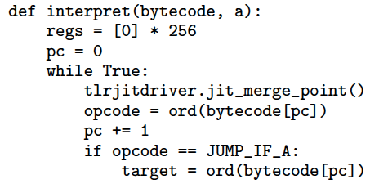
Hint.2 Indicating JIT merge point
It tells "this loop is the beginning of main loop" to JIT compiler
=> JIT compiler can easily detect efficient part to compile

Slide 48
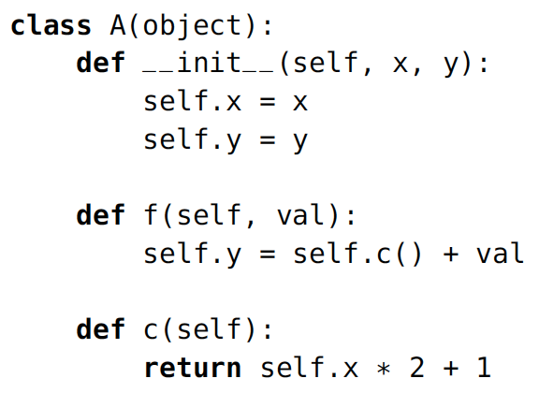
Hint 3. Trace-elidable
It won't be changed
after initial set
It seems that x can be constant-folded!
But!
Python doesn't have private...

Slide 49
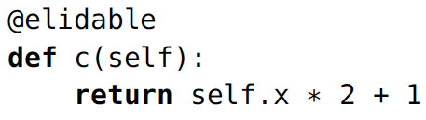
Hint 3. Trace-elidable
A hint for
"This method can be constant-folded"

Slide 50
Summary of "Hinting"
Green variables and red variables
Which is program counter?
JIT merge point
Where is main loop?
Trace elidable
Inform JIT compiler that the method can be constant-folded
These hints are really easy to implement
(almost 1 line!)

Slide 51
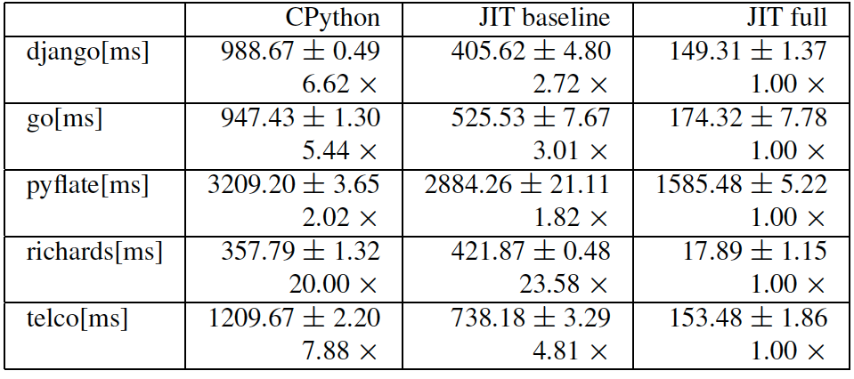
Result of applying hints

Slide 52
In result, it is 5 - 20x faster than CPython!!

Slide 53
How can you utilize PyPy ?
If you use programming language which requires VM to execute in your project..
Introduce VM made by PyPy to make it much efficient!!

Slide 54

For web programmer...
Recently, PyPy version of PHP is under development!

Slide 55
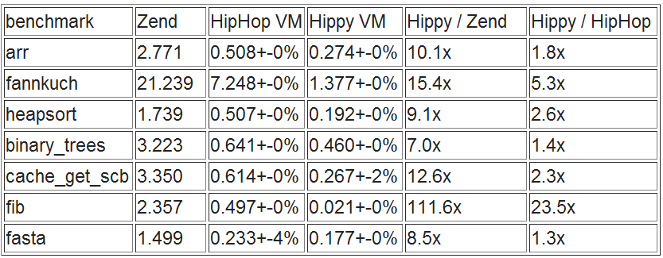
7.0x - 15.4x speed up compared to Zend,
1.3x - 5.3x speed up compared to HipHop
It's still under development, but, it is possible that your web application will be much efficient!

Slide 56
Conclusion
PyPy is a framework for implementing VM in Dynamic language easily , without giving up performance
PyPy uses JIT compiler , which uses meta-tracing, hinting mechanism to achieve great performance (even programmer don't have to implement JIT compiler)
It might be real that all existing interpreter can improve their performance by implement it by PyPy (such as PHP)

Slide 57
Q&A
Of course you can ask me now (please feel free and don't hesitate !)
I will answer your question in these social site
Facebook
Twitter
.... My account can be easily found through PyConJP2012's page!

Slide 58
Fin

Slide 59
Suggestion

Slide 60
Templates
Problem
Problem

